Slide 1
DataZymes – Marketing Mix Walkthrough
Reimagining Pharma Commercial Analytics through Domain, Data and Digital expertise.

Slide 2


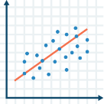

Typical steps in Marketing Mix project
Data discovery
and processing
Segmentation
Modeling
Budget
optimization
Collect required data
Process and QC
Data health check for completeness, accuracy and usability
Summarize data
What, Why & How of segmentation
Identify clusters of customers with similar behaviour in terms of brand sales, market sales, specialty, etc.
HCP level
Attributes-based
Identify relevant segments for modeling
Model helps to evaluate cross channel impact
Use predictive model to evaluate effectiveness of promotional tactics and channels
Identify “baseline” and “impactable” sales
ROI of promotional channels
Design optimization algorithm considering business constraints & parameter estimates from modeling step
Scenario planning to analyse trade-off across marketing mix
Comparison of scenarios
Financial
Strategic
Operational

Slide 3

Promotional Channels
PERSONAL
ACCOUNT MANAGERS
MEDICAL SCIENCE LIASON
SAMPLES
FACE TO FACE CALLS
SPEAKER PROGRAMS
CHAT
VIDEOS
PRINT
CALL CENTER
TV
EMAIL
NON-PERSONAL
WEBSITE
SOCIAL
COMMUNITIES
ONLINE-ADS
WEARABLES
E-DETAILING
MOBILE APPS
Digital Marketing

Slide 4






General datasets/variables needed for Marketing Mix
Response variables
Identify relevant indicator Monthly sales (of selected performance indicator) for study product at Physician / Account level (or lowest granularity available)
Promotions
Identify relevant channels / factors for evaluations Monthly sales for “market” at Physician / Account level (as available) Detailing data (daily, or as available) Activity data for other promotion channels
Brand financials / other files
Sales force information Fully loaded cost of a rep Call capacity/ rep
Brand financials Profit margins or Net price Spend and cost information of various channels
Demographics: Physician demographic Census / Population distribution
“Bridge” files Any bridge file that might be needed to bring different data together, e.g. Current segmentation Physician to ZIP mapping ZIP to DMA Code mapping Physician-to-Account
Detailing (Calls)
Approved Emails
Medical Journal
Units Sold
Revenue Sales
Medical Education
Banner
Competitor Sales
TRx / NRx
Patients Enrolled
Social Media
Promo Call
Managed Care

Slide 5






Level/time of master data sets
Level
Time
Geo: ZIP/
City/Country
Weekly
DMA
Monthly
Account
Quarterly
Physician
Yearly
Prior to modeling, all datasets should be rolled up at common granularity (Level x Time).
However, there would be some static datasets (demographics, specialty mapping, census details) which would be independent of these granularity restrictions

Slide 6

Analysis and Modeling Universe
Analysis Universe
The universe would comprise of doctors :
who are contributing to reasonable sales in the market
who are contributing to reasonable sales of the brand
Who have historically been targeted
Ex – Remove HCPs in bottom 2 deciles except brand writers and called on HCPs
Total HCP Universe (420k HCPs)
Market Writers
Called on
Modeling Universe
A
B
C
D
E
Subset of Analysis Universe
Remove nonconforming data points
Client specific business rules
Possible Modeling Universe - B + C + D + E
Additional business rules:
Remove HCPs in top 8 decile that are not brand writers AND not called on
404,013
3,179
4,482
7,964
991
Brand Writers
*This is illustrative and in most MMX projects, other channels will also play a role in universe selection

Slide 7
Concept of adstocking
What?
Advertising adstock
It is constructed to represent the ‘stock’ of present and past advertising efforts
Captures the prolonged or lagged effect of advertising (advertising memory) on consumer purchasing behavior
Initial advertising
Adstocked advertising (or advertising memory)
Popularity
Used in marketing mix models
Creating advertising & promotional refined variables
Most widely used for TV advertising (modeling GRPs)
Cited in several marketing science journals

Slide 8
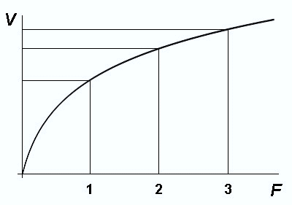
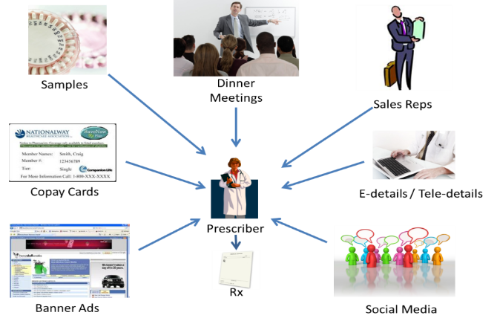
Law of diminishing returns
Law of diminishing returns
The law of diminishing returns states that in all productive processes, adding more of one factor of production, while holding all others constant, will, at some point, yield lower incremental per-unit return
Assisting marketing channels
There are multiple channels of promotion – no single channel is completely responsible for entire sales
Example: Beyond a point, a particular channel promotion cannot make any difference to brand sales as other channels too have an impact on brand sales

Slide 9
Different types of Transformations
Possible transforms
Linear
Non Dimishing Return
Simple, can calculate historical avg ROI but not “optimal”
20
50
Sometimes seen, not useful
15
40
10
30
5
20
10
0
0
2
4
6
8
10
12
14
16
18
20
22
24
26
28
30
0
0
2
4
6
8
10
12
14
16
18
20
22
24
26
28
30
Diminishing Return
Stepwise
Possibly realistic, but hard to model or to act on
Most commonly used
(Negative exponential, Logarithmic, Power (<1)) to calculate “optimal”
15
15
10
10
5
5
0
0
2
4
6
8
10
12
14
16
18
20
22
24
26
28
30
0
0
2
4
6
8
10
12
14
16
18
20
22
24
26
28
30
S Shaped Return
Piecewise Linear
Typically only when data is limited . . .
Accounts for threshold effect
15
100
10
80
60
5
40
20
0
0
2
4
6
8
10
12
14
16
18
20
22
24
26
28
30
0
0
2
4
6
8
10
12
14
16
18
20
22
24
26
28
30
In all models: X axis: Effort Y axis: Return

Slide 10






Promotion Response Model Construct
Model Construct
Product sales in a
given period
Previous period sales
carryover
Channel impactable sales
Promotion in each period
Other factors
HCP Level Model
DMA level Model
Modelling equation
Sales = f{ Sales carryover + B1 * Details + B2 * Speaker Program + Intercept
Sales = f{ Sales carryover + B1 * Details + B2 * Speaker Program + B3 * HCP Banners + B4 * Paid Search
Control
Tactics
Details, Speaker Program
Seasonal variables, Time indicators
Details, Speaker Program, HCP NPP
Details, Speaker Program
Speaker Program
Details, Speaker Program
Seasonal variables, Time indicators
Measured Tactics
Details
Details, Speaker Programs,
HCP NPP
HCP Banners, Paid Search
Consumer NPP
HCP Banners, Paid Search
HCP Banners, Paid Search
0.45/2 Months
0.45/2 Months
0.45/2 Months
Ad-stock factor/Months
0.45/2 Months
Negative Exponential, Log,
Root, Sigmoid curves
0.45/2 Months
Negative Exponential, Log,
Root, Sigmoid curves
Transformation
0.45/2 Months

